Slide 1
Welcome To My Portfolio

Slide 2






Certifications
Click to continue to the Certifications page →

Slide 3
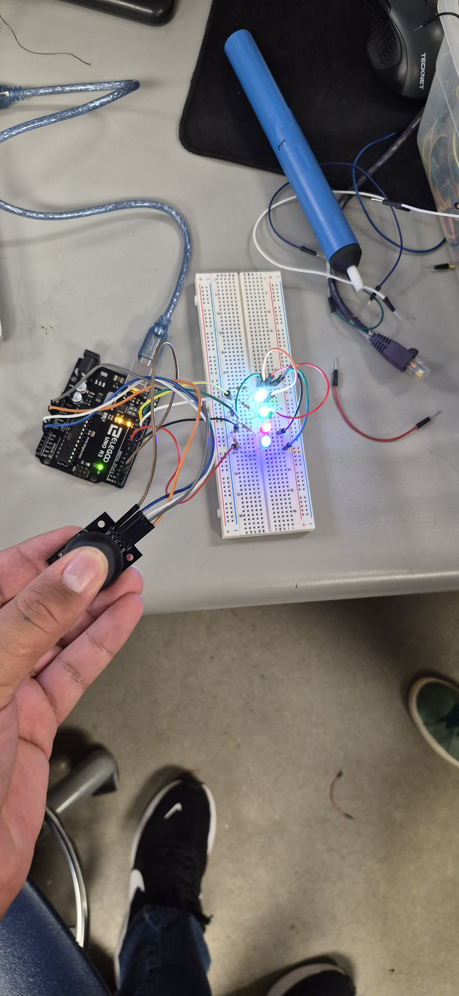
Hardware
See my Hardware projects. I have Experience with breadboarding, schematics, Raspberry pi, Arduino, soldering, and more.
Click to continue to the Hardware page →

Slide 4
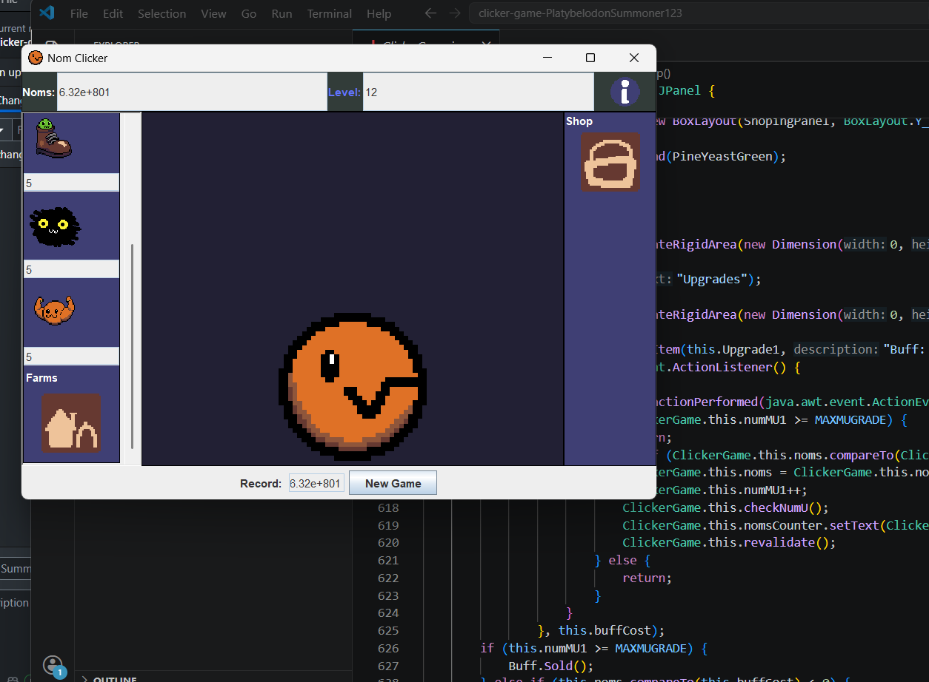
Software
See my Software projects. I have experience in web design, game design, Java, C, C#, solid works, unity, and more.
Click to continue to the Software page →

Slide 5
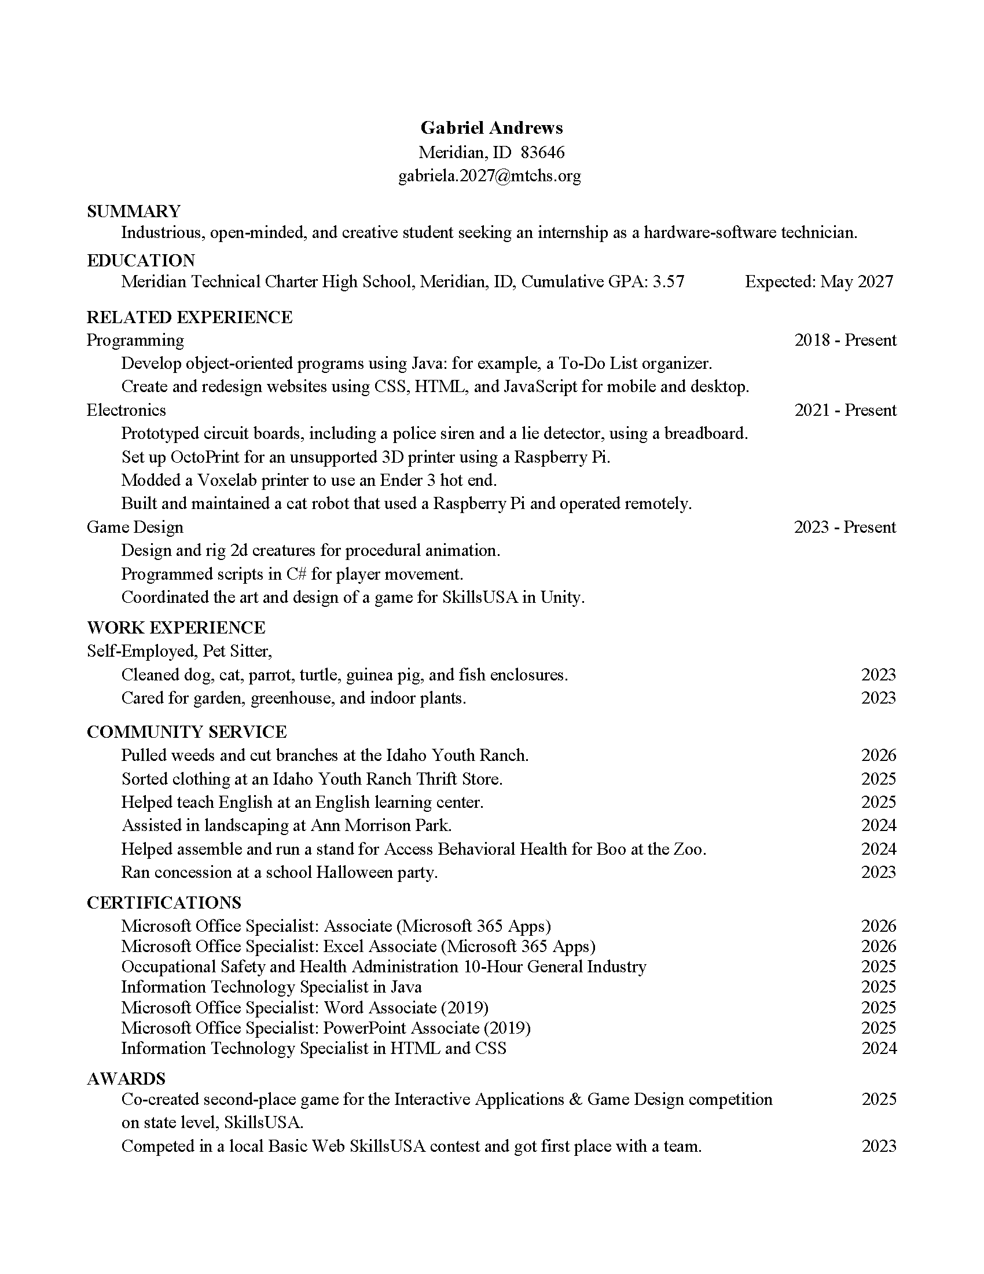
Resume
See my Resume. I have been working hard to build this resume for years.
Click to continue to the Resume page →

